Slide 1
Mastering the Art of Franchising
Greg Mohr
Franchise Maven
greg@franchisemaven.com
361-772-6401
www.franchisemaven.com

Slide 2
Franchising The single most successful marketing strategy ever created -John Naisbitt- author, Megatrends

Slide 3
Franchising
A business with a high success rate
92% success rate overall
89% Success rate with single unit owners
96% Success rate with multi-unit owners

Slide 4
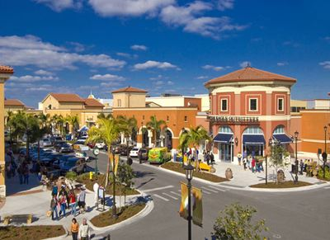
Franchising represents 8% of retail business locations and does over 40% of the retail volume because of:
Brand name recognition
A successful system
Proven support

Slide 5
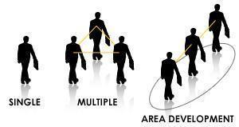
Franchise Types
Single
Multiple Unit
Master Franchise
Regional Development

Slide 6
Master Franchising
The Best Kept Secret in Business Today

Slide 7
Master Franchise Candidate Profile
Strong Leadership skill sets
Relates well with people (good communication skills)
Ability to follow a proven business model
Team Player
Desire to build a Mini Empire with strong work ethic
Market Partner with the Franchisor
Financially strong –
Networth - $750,000+
Liquid Resources - $150,000+

Slide 8
Master Franchising
FRANCHISOR
MASTER
Designated Market Area
E
E
E
E
E
Avg. of 46

Slide 9
Sources of Revenue
Franchise Fee
(40/60 to 60/40)
Initial Fee & Then
Every Ten Years
Royalty Percentage
(2% to 4% of gross)
Avg. Master
Franchisee
Percentage
Inventory Sales
Product

Slide 10
ROI Example:
$240,000 Master License Fee: (Includes “Pilot Location” license fee) ($ 40,000) Included Franchise Fee:
$200,000 Master License Investment
(may develop 20-50 locations in Region)

Slide 11
ROI Example:
Franchise Fee
$40,000 Single Unit Franchise Fee
x 50% (Master / ZOR split)
$20,000 (per unit fee kept by Master)
x 10 (single units sold)
$200,000 total kept by Master

Slide 12
ROI Example:
Royalty Split
8% Single Unit Royalty
x 50% (Master / ZOR split)
4% Master Royalty per Unit
$720,000 (Ex: Annual Revenues / unit)
$ 28,800 Annual Royalty fees per unit/year

Slide 13
Long Term Master Franchise Benefits
After Infrastructure is Built
Running a Region is not time intensive
Ready for other master franchises if desired
Ongoing Royalty Revenue
Exit Strategy
Why have an exit strategy? There’s great cash flow – average exit strategy is 5-7 years
In the event of a sale, multiples are very substantial because value is based upon long-term contractual relationships

